Slide 1



GREEN FAST FOOD
01

Slide 2


THE FOOD GAP BETWEEN GENERATIONS
MAKING FOOD FOR THE COMING YOUNG GENERTION IS BECOMING HARDER AND MORE EXPENSIVE THUS OTHER SOLUTION IS NEEDED.
10

Slide 3

Write Your Solution
in Kenya many youths are unemployed less time to do house work since the majority of married partners are working to make ends meet thus a gap of easy high quality food gap can be establish
06

Slide 4
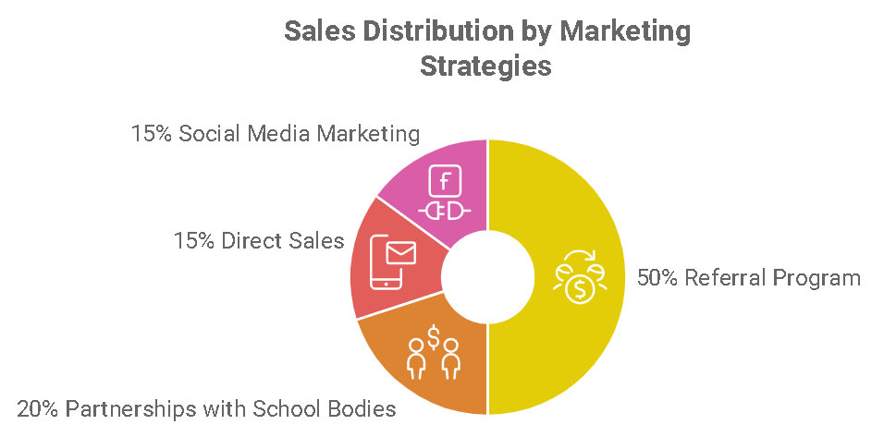
Product
my product will allow order of food with guarantee of delivery coming from a radius of less than seven kilometer from destination
Type here
04

Slide 5



Target Market
2 out 5
Over 60% of young adoults preffer to buy food than cook themselves.
95%
Everybody eats the method of preparations will always be a factor
123 million
The food industry is a multi billion dollar industry that will never go out of market.
14

Slide 6
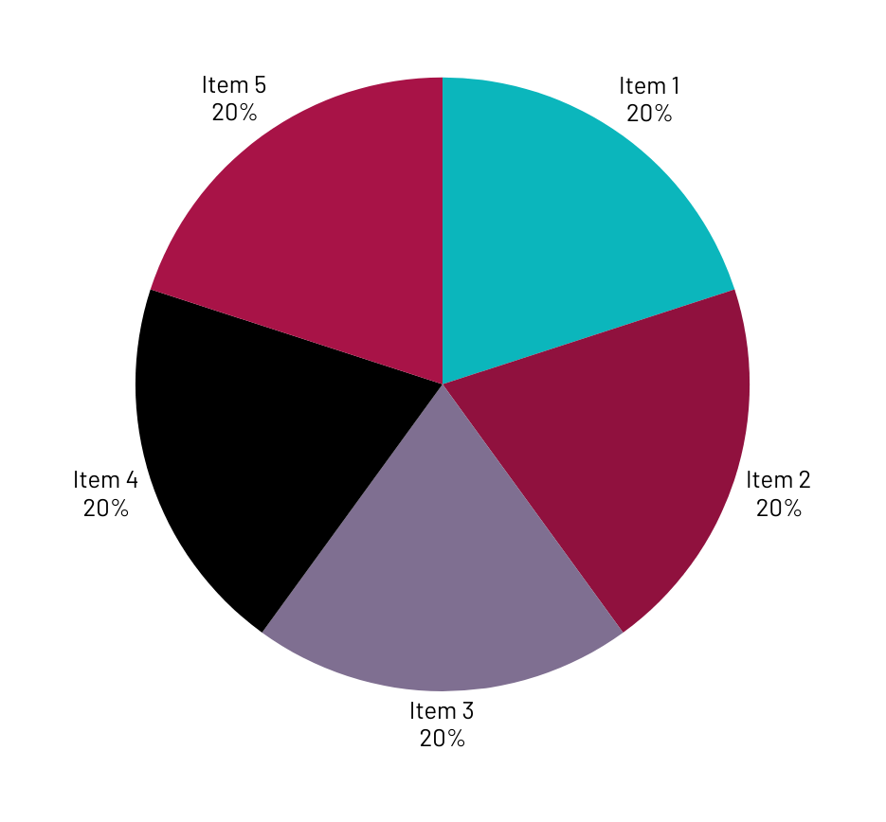
Market Size
Discuss Your market size

Slide 7
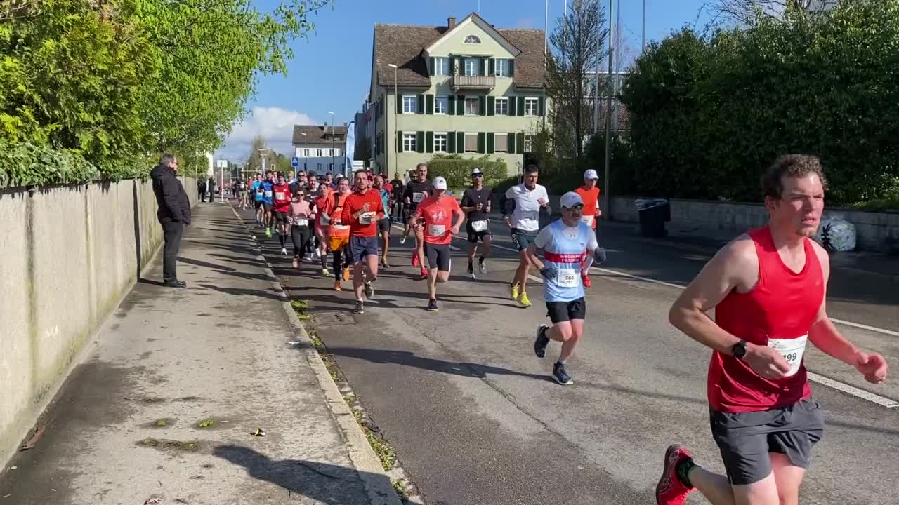
Competitors
KFC –kenttucky fried chicken is an outsde country Taking advantage of this opportunity the main advantage is that our restaurant will consider the culture and a home advantage to the food market
23

Slide 8

Competitive Advantage
OUR competitor advantage is that they are well funded and very popular but our advantage will be that we know the kenya market and will be flexible on menu and producer across te country while have a course that impact back to the community

Slide 9
Project Traction
Tasks
Month 1
Month 2
Month 3
Month 4
Month 5
Finish the site project
Undastanding the market
Try a feasibility study on market
Change if good feed back
Lounch the project
Do marketing for the project
Add people to join the initive
Start getting investor and running the bussiness
23

Slide 10

Business Model
How are you making money?
Through the system when one makes an order or books a sit
What are your profit margins?
It will be according to the source and product from 2% to 15% t
23

Slide 11
Go To Market
Show us how you will reach your customers
Through events and socacil media
Adds and online marketing such as affiliate marketting

Slide 12
Social Impact
What SDGs is your solution addressing, write in point form
Creation of employment
Solve food isse for young people
Give country a growth of its food industry

Slide 13
Our Ask
Clearly state what you are asking for
Asking for a chance and a bit of help to get their
Outline how you intend to use the funds, if you are asking for money
Get the project to the people and hire a few people to market and work for the company

Slide 14


Team Members
Add team members Names and tiles
MWANGI BRIAN IRUNGU
NAME
Title or Position
FOUNDER

Slide 15




Thank you!
Write your contacts here, social media accounts
17

